Slide 1
Effective communications
Lecture 1
Yasir Saleem

Slide 2
What is communication?
See the dictionary:
Effective communication: When someone achieves the desired outcome through communication.
Communication is a dynamic process.
Organizations cannot function efficiently without effective communication.

Slide 3
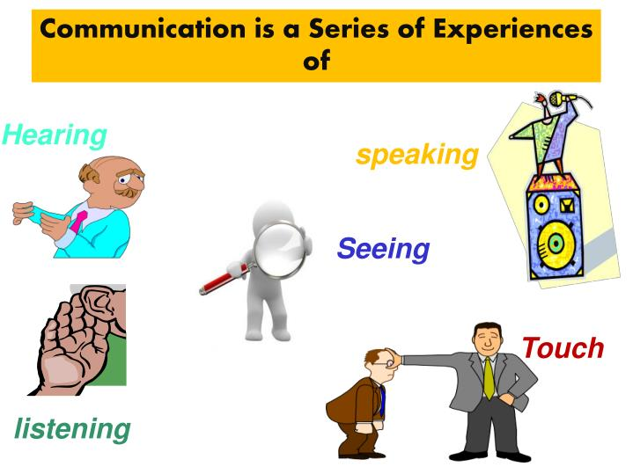
Communication is a series of experiences of

Slide 4
Communication is:
7% WORDS:
Words are only labels, the listeners make their own interpretation of the speaker’s words.
38% PARALINGUISTIC:
The way something is said - the accent, tone and voice modulation is important to the listener.
55% BODY LANGUAGE:
How a speaker looks like while delivering a message has the highest affect on the listener’s understanding.

Slide 5
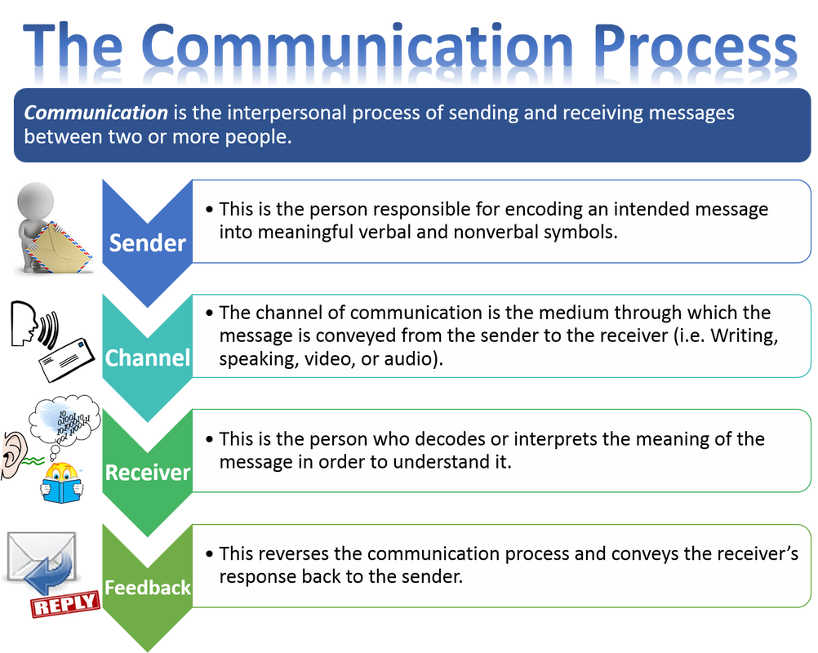

Slide 6
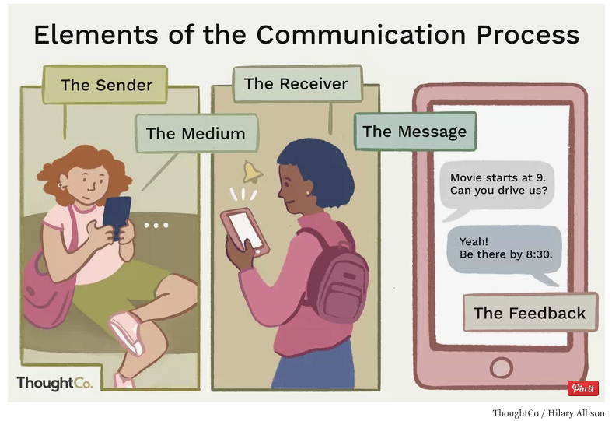
The communication process

Slide 7
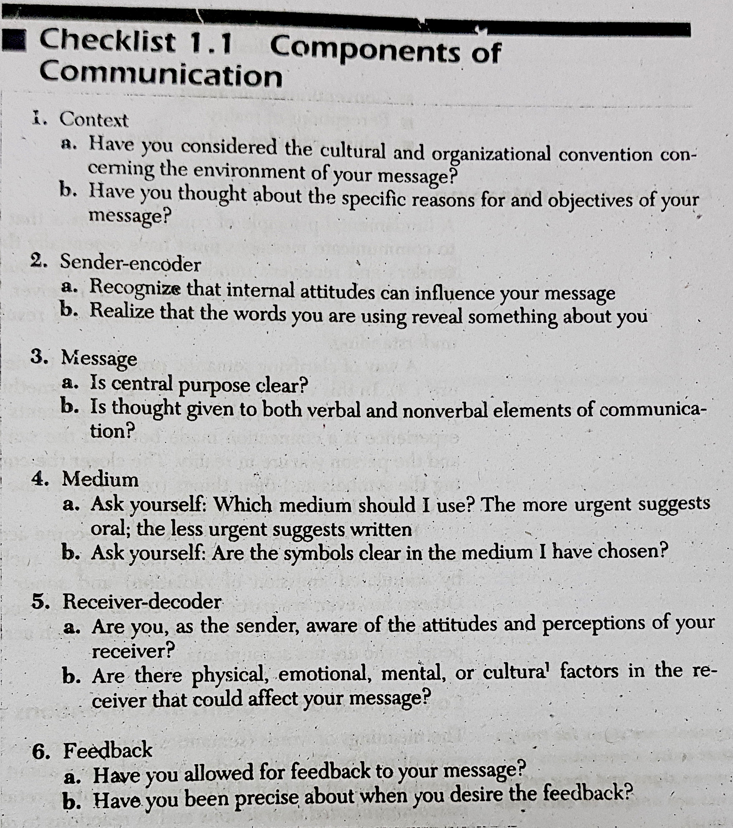

Slide 8
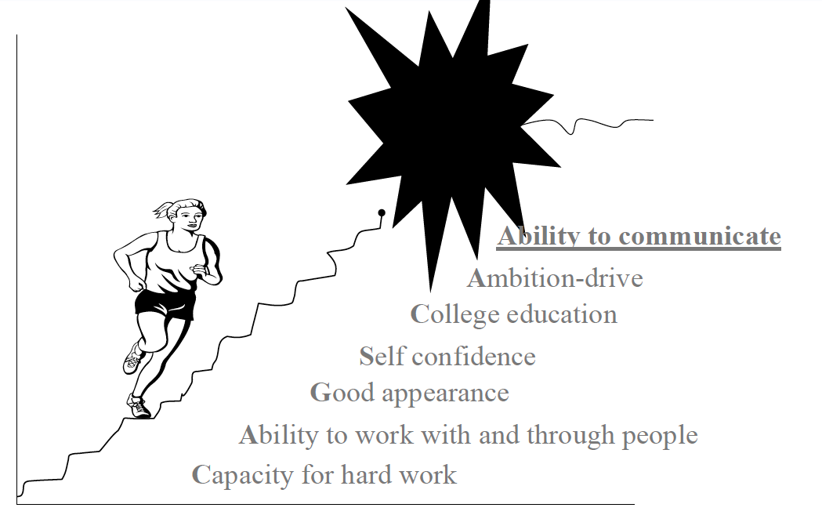

Slide 9
COMMUNICATION IN ORGANIZATIONS
Internal Communication:
Within an organization
External Communication:
With entities outside of the organization

Slide 10
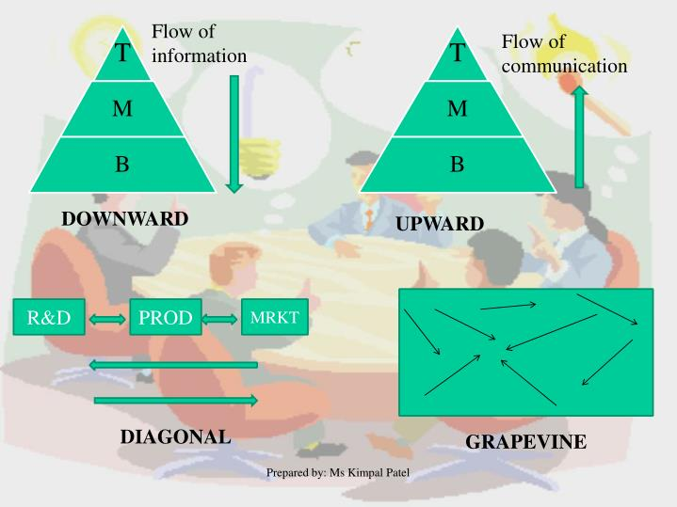
INTERNAL COMMUNICATION
HORIZONTAL
GRAPEVINE

Slide 11
Task 1:
Gather five (05) job ads from the newspaper depicting strong Interpersonal and Communication skills as a requirement

Slide 12
Types of communication
Verbal
Non Verbal
Kinesics: Body language
Vocalics: Paralanguage
Proxemics: Space language
Chronemics: Time language
Haptics: Touch language
Environment
Notes:
Your brother comes home from school and walks through the door. Without saying a word, he walks to the fridge, gets a drink, and turns to head for the couch in the family room. Once there, he plops down, stares straight ahead, and sighs. You notice that he sits there in silence for the next few minutes. In this time, he never speaks a word. Is he communicating? If your answer is yes, how would you interpret his actions? How do you think he is feeling? What types of nonverbal communication was your brother using? Like verbal communication, nonverbal communication is essential in our everyday interactions.

Slide 13
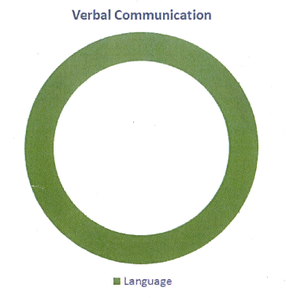
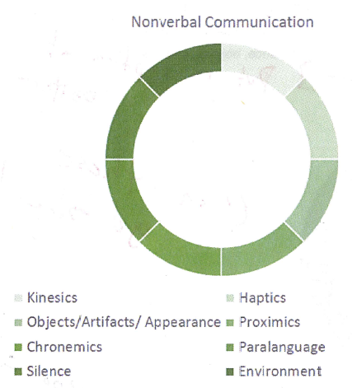
Difference between verbal and non-verbal communication
Verbal – Single Channel
Non-Verbal – Multiple Channel
Verbal communication is distinct (linear) while Nonverbal communication is continuous (in constant motion and relative to context) – Analog and Digital Clock
Notes:
The first difference between verbal and nonverbal communication is that we use a single channel (words) when we communicate verbally versus multiple channels when we communicate nonverbally. Try this exercise! Say your first and last name at the same time. You quickly find that this is an impossible task. Now, pat the top of your head with your right hand, wave with your left hand, smile, shrug your shoulders, and chew gum at the same time. While goofy and awkward, our ability to do this demonstrates how we use multiple nonverbal channels simultaneously to communicate.
If you pronounce the word “cat” you begin with the letter “C” and proceed to finish with “T.”

Slide 14
Difference between verbal and non-verbal communication
We use verbal communication consciously while we generally use nonverbal communication unconsciously.
Verbal communication is exclusive to the users of a particular language dialect, whereas some nonverbal communication is recognized across cultures.
Let us sum up the ways in which nonverbal communication is unique:
Nonverbal communication uses multiple channels simultaneously.
Nonverbal communication is continuous.
Nonverbal communication can be both conscious and unconscious.
Certain nonverbal communication is universally understood.
Notes:
he explains that men are not as good at reading body language cues as women because they use different areas of their brain when decoding. She states, “women might be better at reading body language because … [they] have 14 to 16 active brain areas while evaluating others, whereas men only have 4 to 6 active.”
For instance, people around the world recognize and use expressions such as smiles, frowns, and the pointing of a finger at an object. Note: Not all nonverbal gestures are universal! For example, if you travel to different regions of the world, find out what is appropriate! For example if you go to South Korea don’t offer payment with only one hand.

Slide 15
Kinesics: Body language
(P)OSTURES & GESTURES How do you use hand gestures?
(E)YE CONTACT How’s your “Lighthouse”?
(O)RIENTATION How do you position yourself?
(P)RESENTATION How do you deliver your message?
(L)OOKS Are your looks, appearance, dress important?
(E)XPRESSIONS OF EMOTION Are you using facial expressions to express emotion?
Notes:
For example, imagine yourself at a party and you see someone across the room you are attracted to.

Slide 16
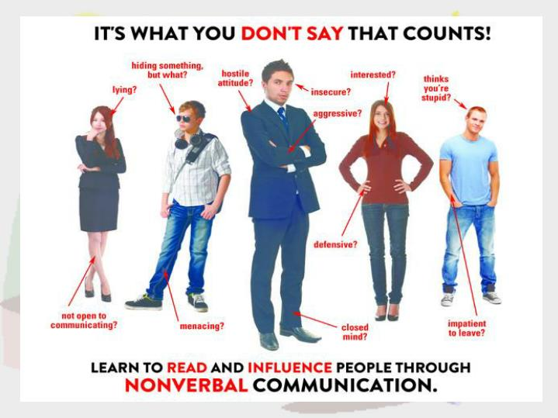

Slide 17
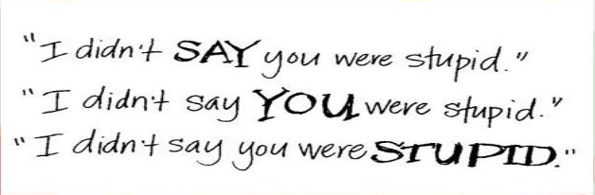
Vocalics: Paralanguage
Paralanguage is the term we use to describe vocal qualities such as pitch, volume, inflection, rate of speech, and rhythm. Sarcasm and incongruence are two examples of this.
It involves HOW of a speaker’s voice rather than WHAT of the words.
Silence serves as a type of nonverbal communication when we do not use words or utterances to convey meanings.
Notes:
Women In Black
An organization of women called Women in Black uses silence as a form of protest and hope for peace; particularly, peace from war and the unfair treatment of women. Women in Black began in Israel in 1988 by women protesting Israel’s Occupation of the West Bank and Gaza. Women in Black continues to expand and now functions in the United States, England, Italy, Spain, Azerbaijan and Yugoslavia. Women gather in public spaces, dressed in black, and stand in silence for one hour, once a week. Their mission states, “We are silent because mere words cannot express the tragedy that wars and hatred bring.
Whenever you use sarcasm, your paralanguage is intended to contradict the verbal message you say. As Professors we have found that using sarcasm in the classroom can backfire when students do not pick up our paralinguistic cues and focus primarily on the verbal message. We have learned to use sarcasm sparingly so as not to hurt anyone’s feelings.

Slide 18
Haptics: Touch language
Touch is the first type of nonverbal communication we experience as humans and is vital to our development and health (Dolin & Booth-Butterfield; Wilson, et al.)
We use touch to share feelings and relational meanings. Hugs, kisses, handshakes, demonstrate relational meanings and indicate relational closeness.
The friendly shoulder pat
The stroke over the head
The arm around someone's shoulder
In our society, touch is largely reserved for family and romantic

Slide 19
Chronemics: Time language
Chronemics is the study of how people use time. Are you someone who is always early or on-time? Or, are you someone who arrives late to most events?
You may have heard the expression, “Indian time” to refer to “the perception of time [that] is circular and flexible”

Slide 20
Proxemics: Space language
Proxemics is the study of how our use of space influences the ways we relate with others.
Intimate space: ranges from touch to eighteen inches (family members, close friends, and intimate partners). Intimate space is also the context for physical fighting and violence.
Personal space: ranges from eighteen inches to four feet and is reserved for most conversations with friends and acquaintances.
Social space: extends from four to twelve feet and is used for small group interactions such as sitting around a dinner table with others or a group meeting
Public space extends beyond twelve feet and is most often used in public speaking situations. We use space to regulate our verbal communication and communicate relational and social meanings.
Notes:
A fun exercise to do is to go to a public space and observe people. Based on their use of the above categories of space, try to determine what type of relationship the people are in: Romantic, Family, or Friends.

Slide 21
Environment
Our environment are nonverbal acts through our use of spaces we occupy like are homes, rooms, cars, or offices.
Most educational institutions intentionally paint classrooms in dull colors. Why? Dull colors on walls have a calming effect, theoretically keeping students from being distracted by bright colors and excessive stimuli.
Restaurants and meeting rooms have uncomfortable chairs.
Notes:
Feng Shui
Feng Shui, which means wind and water, is the ancient Chinese art of living in harmony with our environment. Feng Shui can be traced as far back as the Banpo dwellings in 4000 BCE. The ideas behind Feng Shui state that how we use our environment and organize our belongings affects the energy flow (chi) of people in that space, and the person/people who created the environment. The inclusion or exclusion, and placement, of various objects in our environments are used to create a positive impact on others. The theory is to use the five elements of metal, wood, water, fire and earth to design a space. Feng Shui is applicable to cities, villages, homes, and public spaces. The Temple of Heaven in Bejing, China is an example of Feng Shui architecture. To keep harmony with the natural world, the Temple houses the Hall of Annual Prayer which is comprised of four inner, 12 middle, and 12 outer pillars representing the four seasons, 12 months, and 12 traditional Chinese hours.

Slide 22
Functions of non-verbal communication
We use nonverbal communication to duplicate verbal communication.
We use nonverbal communication to replace verbal communication.
We use nonverbal cues to complement verbal communication.
We use nonverbal communication to accent verbal communication.
We use nonverbal communication to regulate verbal communication.
We use nonverbal communication to contradict verbal communication.
We use nonverbal communication to mislead others.
We use nonverbal communication to indicate relational standing.
We use nonverbal communication to communicate emotions.
Notes:
Head nod with yes
Babies nods yes or no
Hugs
I am VERY disappointed I am VERY angry with you
Rarely, if ever, would we approach a person and say, “I’m going to start a conversation with you now. Okay, let’s begin.” Instead, we might make eye contact, move closer to the person, or face the person directly
Yawning in class
Eat Like a Lady In Japan it is considered improper for women to be shown with their mouths open in public. So, in 2013, the Japenese Burge chain, Freshness Burger, developed a solution: the liberation wrapper. The wrapper, or mask, hides women’s mouths as they eat thus allowing them to maintain the expected gendered nonverbal behavior for the culture.
ake a few moments today to observe the nonverbal communication of people you see in public areas. What can you determine about their relational standing from their nonverbal communication? For example, romantic partners tend to stand close to one another and touch one another frequently.
We tend to interpret emotions by examining nonverbal communication. For example, a friend may be feeling sad one day and it is probably easy to tell this by her nonverbal communication.
Likewise, those in close relationships can more often detect concealed emotions

Slide 23
Nonverbal Communication and Getting a Job
You may be thinking that getting the right degree at the right college is the way to get a job. Think again! It may be a good way to get an interview, but once at the interview, what matters? College Journal reports that, “Body language comprises 55% of the force of any response, whereas the verbal content only provides 7%, and paralanguage, or the intonation — pauses and sighs given when answering — represents 38% of the emphasis.” If you show up to an interview smelling of cigarette smoke, chewing gum, dressed inappropriately, and listening to music on your phone, you’re probably in trouble.
About.Com states that these are some effective nonverbal practices during interviews:
Make eye contact with the interviewer for a few seconds at a time.
Smile and nod (at appropriate times) when the interviewer is talking, but, don’t overdo it. Don’t laugh unless the interviewer does first.

Slide 24
Non-verbal Communication and Getting a Job
Be polite and keep an even tone to your speech. Don’t be too loud or too quiet.
Don’t slouch.
Do relax and lean forward a little towards the interviewer so you appear interested and engaged.
Don’t lean back. You will look too casual and relaxed.
Keep your feet on the floor and your back against the lower back of the chair.
Pay attention, be attentive and interested.
Listen.
Don’t interrupt.
Stay calm. Even if you had a bad experience at a previous position or were fired, keep your emotions to yourself and do not show anger or frown.
Not sure what to do with your hands? Hold a pen and your notepad or rest an arm on the chair or on your lap, so you look comfortable. Don’t let your arms fly around the room when you’re making a point.

Slide 25
Thank you

